Slide 1
Crash Recovery
SUN YAT-SEN UNIVERSITY
Notes:
1

Slide 2
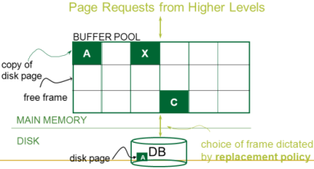
Review
事务的4个特性 ACID
事务的提交与中止
并发控制，严格 2PL
Buffer Management,脏页

Slide 3
Review: The ACID properties
Atomicity: All actions in the Xact (transaction) happen, or none happen.
Consistency: If each Xact is consistent, and the DB starts consistent, it ends up consistent.
Isolation: Execution of one Xact is isolated from that of other Xacts.
Durability: If an Xact commits, its effects persist.
The Recovery Manager guarantees Atomicity & Durability.

Slide 4
Motivation 动机
The Recovery Manager guarantees Atomicity & Durability.
Atomicity: All actions in the Xact (transaction) happen, or none happen.
  Transactions may abort (“Rollback”).
Durability: If an Xact commits, its effects persist.
  What if DBMS stops running? (Causes?)
Desired state after system restarts:
T1 & T3 should be durable.
T2, T4 & T5 should be aborted (effects should not be seen).
crash!
T1
T2
T3
T4
T5
Commit
Abort
Commit

Slide 5
Assumptions
Crash Recovery
Concurrency control is in effect.
  Strict 2PL, in particular.
Updates are happening “in place”.
  i.e., data is overwritten on (deleted from) the disk.
Atomic Writes: writing a page to disk is an atomic action.
  In practice, additional details are needed to deal with non-atomic writes.

Slide 6
Buffer Management Policy Plays a Key Role
Crash Recovery
1、提交前写策略？
Shall we allow “dirty pages” in the buffer pool caused by an Xact T to be written to disk before T commits?
  If so, a second Xact T‘ can “steal” a frame from T. -偷帧
  In contrast, No-Steal.
When an Xact T commits, must we ensure that all the “dirty pages” of T are immediately forced to disk?
  If so, we say that a “force” approach is used. – 强制写
  In contrast, No-Force.
（提高并发度）
（易实现UNDO ）
2、提交后不写策略？
(易实现Durability)
好处：降低IO开销（如：同一“脏页” 多次写）

Slide 7
Variants of Buffer Management Policy
1、提交前写策略？
恢复策略？
（易实现UNDO ）
（提高并发度）
No Steal
Steal
No Steal
Steal
（降低IO开销）
No Force
Fastest
No UNDO
UNDO
No Force
REDO
REDO
2、提交后不写策略？
No UNDO
UNDO
Force
Slowest
Force
(易实现Durability)
No REDO
No REDO
Performance
Implications
Logging/Recovery
Implications

Slide 8
Preferred Policy: Steal/No-Force
1、提交前写策略（高并发）
2、提交后不写策略（低IO）
STEAL (偷帧,why enforcing Atomicity is hard)
  To steal frame F: Current page in F (say P) is written to disk; some Xact holds lock on P.
    问题:What if the Xact with the lock on P aborts?
    解决:Must remember the old value of P at steal time (to support UNDOing the write to page P).
NO FORCE (非强制写,why enforcing Durability is hard)
  问题:What if system crashes before an updated page is written to disk?
  解决:Write as little as possible, in a convenient place, at commit time, to support REDOing modifications.

Slide 9



Basic Idea: Logging-写日志
Record REDO and UNDO information, for every update, in a log(日志).
  Sequential writes to log (put it on a separate disk).
  Minimal information (difference) written to log, so multiple updates fit in a single log page.
Log: An ordered list of REDO/UNDO actions
  Log record contains:
    <XID, pageID, offset, length, old data, new data>
  and additional control info (which we’ll see soon).
Notes:
7

Slide 10
The Write-Ahead Logging (WAL) Protocol
先写日志
先写 UNDO action
#1 Must force the log record for an update to disk before the corresponding data page gets to disk.
  This rule helps guarantee Atomicity.
  This allows us to implement Steal policy.
#2 Must write all log records for an Xact to disk before commit.
  I.e. transaction is not committed until all of its log records including its “commit” record are written to disk.
  This rule helps guarantee Durability.
  This allows us to implement No-Force policy.
Exactly how is logging (and recovery!) done?
  We’ll look at the ARIES algorithms from IBM.
从实现角度定义“事务是否已提交？”

Slide 11


WAL & the Log
DB
RAM
LSNs
pageLSNs
flushedLSN
（使用LOG可以重构DB，即每个data page ）
Each log record has a unique
Log Sequence Number (LSN). –日志顺序码
  LSNs is always increasing.
System keeps track of flushedLSN.
  The max LSN flushed so far.
Each data page contains a pageLSN.
  The LSN of the most recent log record for an update to that page.
WAL: Before page i is written to disk,
log must satisfy:
  pageLSN_{i} ≤ flushedLSN,
  i.e., the log record identified by
  pageLSN_{i} must have been written
  to disk for page i is written to disk.
Log records
flushed to disk
对应于LOG的某个状态，
不同data page的对应状态可能不同）
flushedLSN
pageLSN
“Log tail”
in RAM

Slide 12
Log Records
prevLSN is the LSN of the previous log record written by this Xact (so records of an Xact form a linked list backwards in time)
Possible log record types:
Update, Commit, Abort
Checkpoint (for log maintainence)
Compensation Log Records (CLRs)
  for UNDO actions
End (end of commit or abort)
LogRecord fields:
LSN
prevLSN
XID
type
pageID
update
records
only
length
offset
before-image
after-image

Slide 13
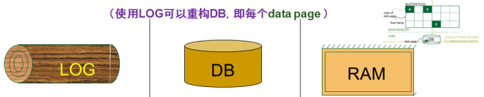
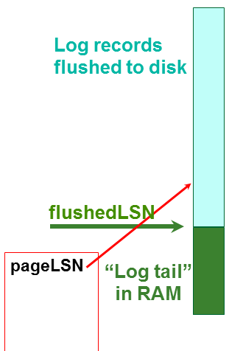
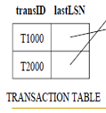
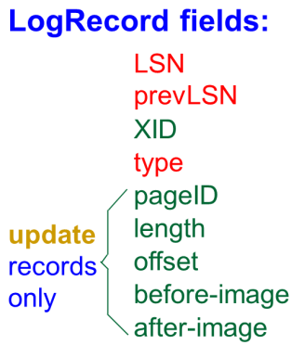
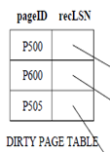
Other Log-Related Data Structures
Two in-memory tables:
Transaction Table-事务表
  One entry per currently active Xact.
    entry removed when Xact commits or aborts
  Contains XID, status (running/committing/aborting), and lastLSN (most recent LSN written by Xact).
Dirty Page Table-脏页表:
  One entry per dirty page currently in buffer pool.
  Contains recLSN -- the LSN of the log record which first caused the page to be dirty.
（反向链表，支持 UNDO）
（顺序扫描，支持 REDO）

Slide 14
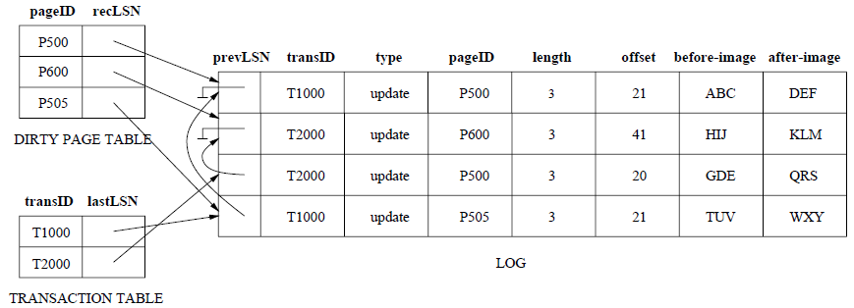
An Example

Slide 15
The Big Picture: What’s Stored Where
（使用LOG可以重构DB，即每个data page ）
LOG
DB
RAM
LogRecords
LSN
prevLSN
Xact Table
lastLSN
status
Dirty Page Table
recLSN
flushedLSN
Data pages
each
with a
pageLSN
XID
type
pageID
length
Master record
LSN
of most recent
checkpoint record
offset
before-image
after-image

Slide 16

Normal Execution of an Xact
通过Log 实现崩溃恢复，要求事务的执行满足以下条件：
Series of reads & writes, followed by commit or abort.
Strict 2PL.
STEAL, NO-FORCE buffer management, with Write-Ahead Logging.

Slide 17
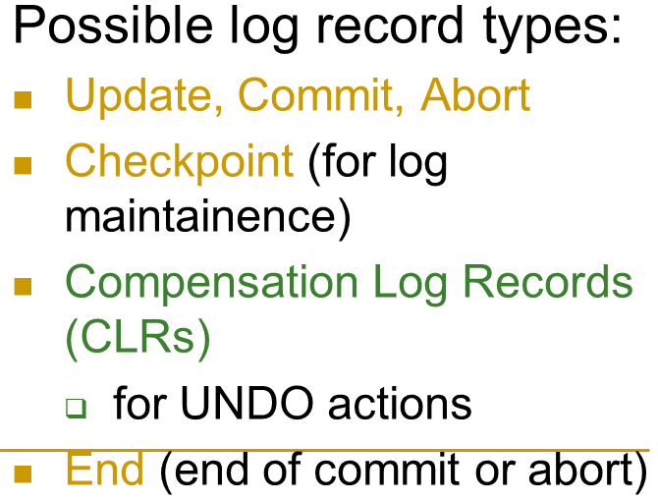
Transaction Commit
Write commit record to log.
All log records up to Xact’s commit record are flushed to disk.
  Guarantees that flushedLSN ≥ lastLSN.
  Note that
    log flushes are sequential, synchronous
    writes to disk.
    Many log records per log page.
Commit() returns.
Write end record to log.
从实现角度定义“事务是否已提交？”
强制写日志的情况：
事务提交
偷帧
页满？

Slide 18
Simple Transaction Abort
For now, consider an explicit abort of an Xact.
  No crash involved.
We want to “play back” the log in reverse
order, UNDOing updates.
  Get lastLSN of Xact from Xact table.
  Write an Abort log record before starting to rollback operations
  Can follow chain of log records backward via the prevLSN field.
  Write a “CLR” (compensation log record-补偿日志记录) for each undone operation.
（反向链表，支持 UNDO）

Slide 19

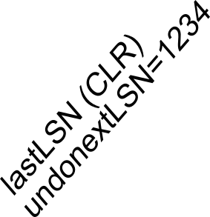
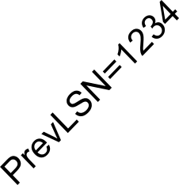


Abort, cont.
To perform UNDO, must have a lock on data!
  No problem! (原因:Strict 2PL. )
Before restoring old value of a page, write a CLR:
  You continue logging while you UNDO!!
  CLR has one extra field: undonextLSN
    Points to the next LSN to undo (i.e. the prevLSN of the record we’re currently undoing).
  CLR contains REDO info
  CLRs never Undone
    Undo needn’t be idempotent (>1 UNDO won’t happen)
    But they might be Redone when repeating history (=1 UNDO guaranteed)
At end of all UNDOs, write an “end” log record.
…, before-image, after-image

Slide 20
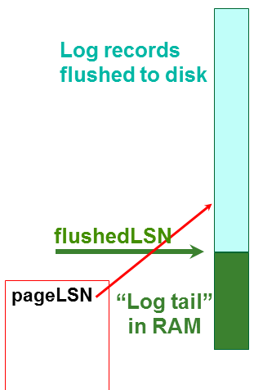
Checkpointing-检查点
Usually, we can not keep log around for all time.
Periodically, the DBMS creates a checkpoint
  Minimizes recovery time after crash.
  Write to log:
    begin_checkpoint record: Indicates when the checkpoint began.
    end_checkpoint record: Contains current Xact table and dirty page table. A`fuzzy checkpoint’-模糊检查点:
      Other Xacts continue to run; so these tables accurate only as of the time of the begin_checkpoint record.
      No attempt to force dirty pages to disk; effectiveness of checkpoint limited by oldest unwritten change to a dirty page.
    Store LSN of most recent checkpoint record in a safe place (master record).
强制写日志的情况：
事务提交
偷帧
页满？
写 master record

Slide 21
Crash Recovery: Big Picture
Oldest log rec. of Xact active at crash
Start from a checkpoint (found via master record).
Three phases. Need to do:
  Analysis - Figure out which Xacts committed since checkpoint, which failed.
  REDO all actions.
    (repeat history)
  UNDO effects of failed Xacts.
Smallest recLSN in dirty page table after Analysis
Last chkpt
CRASH
A
R
U

Slide 22
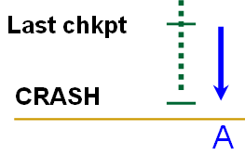
Recovery: The Analysis Phase
恢复事务表与脏页表
Re-establish knowledge of state at checkpoint.
  via transaction table and dirty page table stored in the
  checkpoint
Scan log forward from the most recent checkpoint.
  End record: Remove Xact from Xact table.
  All Other records: Add Xact to Xact table, set lastLSN=LSN,
    change Xact status on commit record.
    also, for Update records: If page P not in Dirty Page Table (DPT),
    Add P to DPT, set its recLSN=LSN.
At the end of Analysis…
  Xact table says which xacts were active at time of crash.
  DPT says which dirty pages might not have been written to disk.

Slide 23
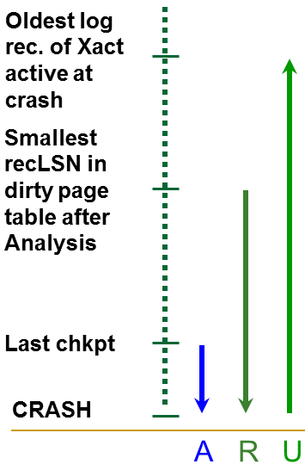
Phase 2: The REDO Phase
恢复赃页
We Repeat History to reconstruct state at crash:
  Reapply all updates (even of aborted Xacts!), redo CLRs.
Scan forward from log record containing smallest recLSN in DPT.
For each update log record or CLR with a
given LSN, REDO the action unless:
  Affected page is not in the DPT, or
  Affected page is in DPT, but has
    recLSN > LSN, or
    pageLSN (in DB) ≥ LSN. (this last case requires I/O)
To REDO an action:
  Reapply logged action.
  Set pageLSN to LSN. No additional logging, no forcing!
…, before-image, after-image

Slide 24
Phase 3: The UNDO Phase
UNDO未完成事务
A Naïve solution:
  The xacts in the Xact Table are losers(失败事务).
  For each loser, perform simple transaction abort.
  Problems?

Slide 25
Phase 3: The UNDO Phase
ToUndo={lastLSNs of all Xacts in the Xact Table}
a.k.a. “losers”
Repeat:
  Choose (and remove) largest LSN among ToUndo.
  If this LSN is a CLR and undonextLSN==NULL
    Write an End record for this Xact.
  If this LSN is a CLR, and undonextLSN != NULL
    Add undonextLSN to ToUndo
  Else this LSN is an update. Undo the update, write a CLR, add prevLSN to ToUndo.
Until ToUndo is empty.
NOTE: This is simply a performance optimization on the naïve solution to do it in one backwards pass of the log!
…, before-image, after-image

Slide 26
Example of Recovery
脏页表
pageID | recLSN
P5 | 10
P3 | 20
P1 | 50
事务表
transID | lastLSN
T1 | 40
T2 | 60
T3 | 50
LSN LOG
RAM
00
05
10
20
30
40
45
50
60
begin_checkpoint
end_checkpoint
update: T1 writes P5
update T2 writes P3
T1 abort
CLR: Undo T1 LSN 10
T1 End
update: T3 writes P1
update: T2 writes P5
CRASH, RESTART
Xact Table
lastLSN
status
Dirty Page Table
recLSN
flushedLSN
prevLSNs
ToUndo

Slide 27
Example:
Crash During Restart!
脏页表
pageID | recLSN
P5 | 10
P3 | 20
P1 | 50
事务表
transID | lastLSN
T1 | 40
T2 | 70
T3 | 80
LSN LOG
00,05
10
20
30
40,45
50
60
70
80,85
90
begin_checkpoint, end_checkpoint
update: T1 writes P5
update T2 writes P3
T1 abort
CLR: Undo T1 LSN 10, T1 End
update: T3 writes P1
update: T2 writes P5
CRASH, RESTART
CLR: Undo T2 LSN 60
CLR: Undo T3 LSN 50, T3 end
CRASH, RESTART
CLR: Undo T2 LSN 20, T2 end
RAM
undonextLSN
Xact Table
lastLSN
status
Dirty Page Table
recLSN
flushedLSN
ToUndo

Slide 28
Additional Crash Issues
What happens if system crashes during Analysis? During REDO?
How do you limit the amount of work in REDO?
  Flush asynchronously in the background.
How do you limit the amount of work in UNDO?
  Avoid long-running Xacts.
1、恢复事务表与脏页表
2、恢复赃页
3、UNDO未完成事务

Slide 29
Summary of Logging/Recovery
Recovery Manager guarantees Atomicity & Durability.
Use WAL to allow STEAL/NO-FORCE w/o sacrificing correctness.
LSNs identify log records; linked into backwards chains per transaction (via prevLSN).
pageLSN allows comparison of data page and log records.

Slide 30
Summary (Contd.)
Checkpointing: A quick way to limit the amount of log to scan on recovery.
Recovery works in 3 phases:
  Analysis: Forward from checkpoint.
  Redo: Forward from oldest recLSN.
  Undo: Backward from end to first LSN of oldest Xact alive at crash.
Upon Undo, write CLRs.
Redo “repeats history”: Simplifies the logic!

Slide 31
Summary
要求:
  理解Crash Recovery的3个阶段算法，相应的例子
  能够根据给定日志进行崩溃恢复，即
    恢复事务表、脏页表
    为日志添加因UNDO而生成的CLR和END日志记录

